Slide 1
Obelisk 2
A Peter Richard Ott Production
Notes:
This is Obelisk 2 – the sequel to last year’s “Obelisk” created by Ushan Abeysekera, Ben Mosier, and myself.

Slide 2
Disclaimer:
The depiction of any weapon in this game does not indicate affiliation, sponsorship, or endorsement by any weapon manufacturer.
The use of blood in this game is optional. Enabling blood through the menu reflects the player’s own consent.

Slide 3
Game Play
Choices
Time Scale
Artificial Intelligence
Notes:
Choose your own weapons, map paths, and play styles with intricate maps, nonrestrictive gameplay, and a multitude of weapons.
Time Scale – also know as slow motion – lets the play shoot more accurately, appreciate the gameplay, and adds style to the overall game.
The AI – or artificial intelligence – uses a path finding algorithm to find players throughout the map.

Slide 4
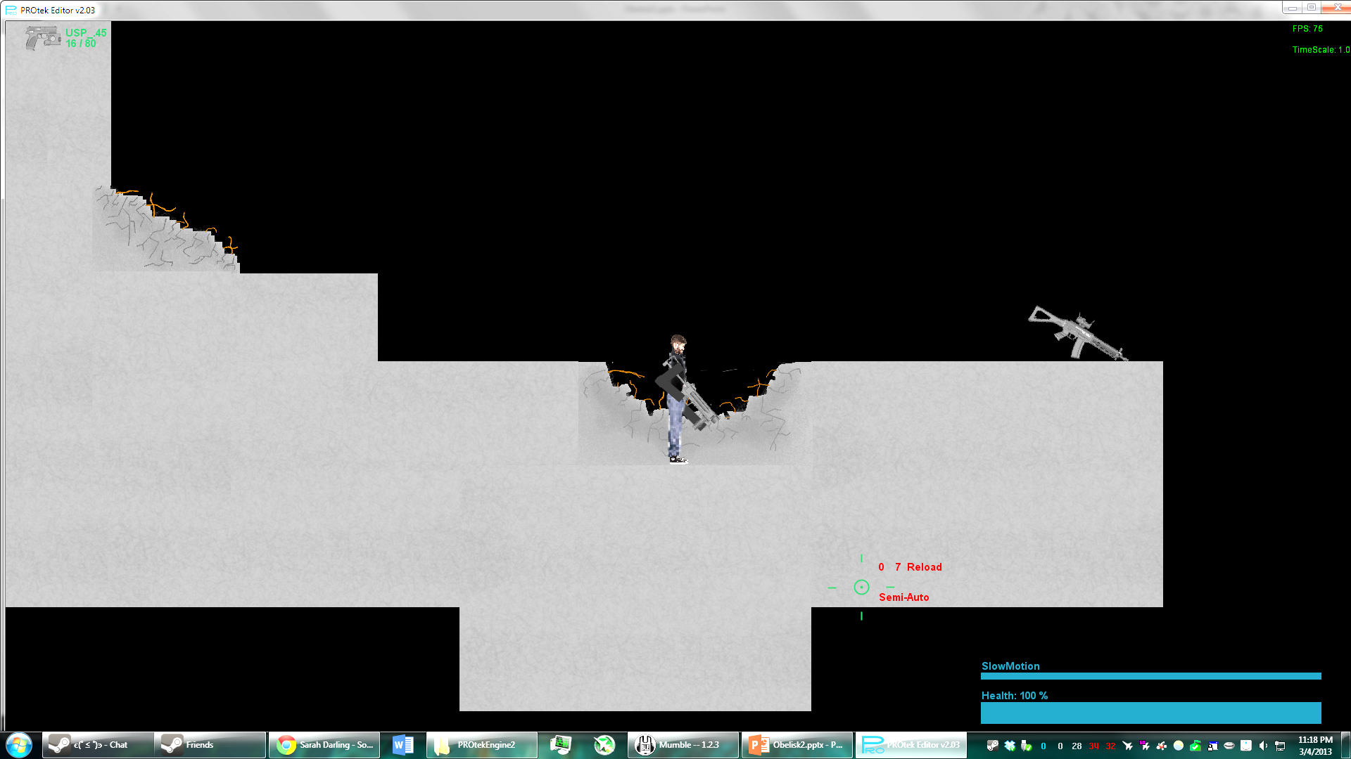





Choices
37 Different Weapons
7 Assault Rifles
3 SMGs
3 High Powered Rifles
2 Shotguns
Crossbow and other special weapons
Notes:
There are 37 weapons that are useable in the game that can be bought with points from the in-game store.
Each weapon has different attributes; such as magazine size, rate of fire, and damage.

Slide 5
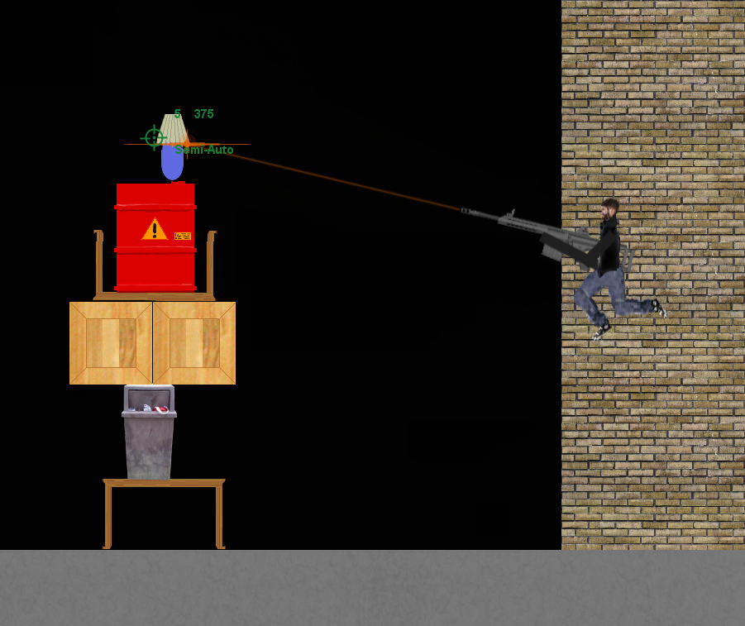
Time Scale
Allows for accuracy and appreciation
Notes:
Slow Motion allows an added amount of accuracy to gameplay for added precision to gunfire.

Slide 6
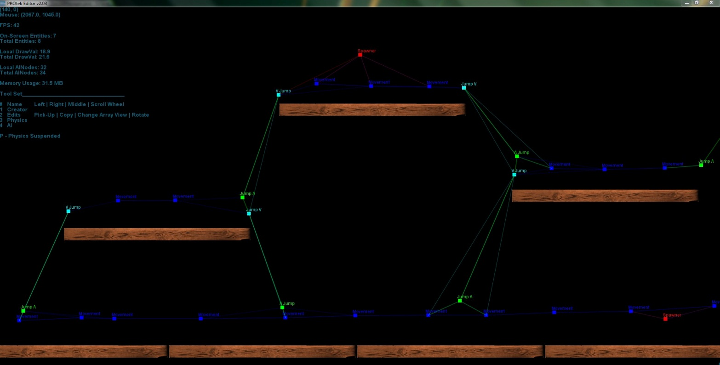
Artificial Intelligence
AINodes create networks to locate, track, and follow players.
Special AINodes are used to specifying AI Behavior
Notes:
What good would a game be if there was no AI. The PROTEK Engine uses a web-like structure of managing its AI. These webs find the player and tell the AIs how and where to move next to get closer to the player.

Slide 7
Graphical Beauty
Motion Blur
Particle System
Destructible Environments
Multi-Threaded Constant Physics

Slide 8
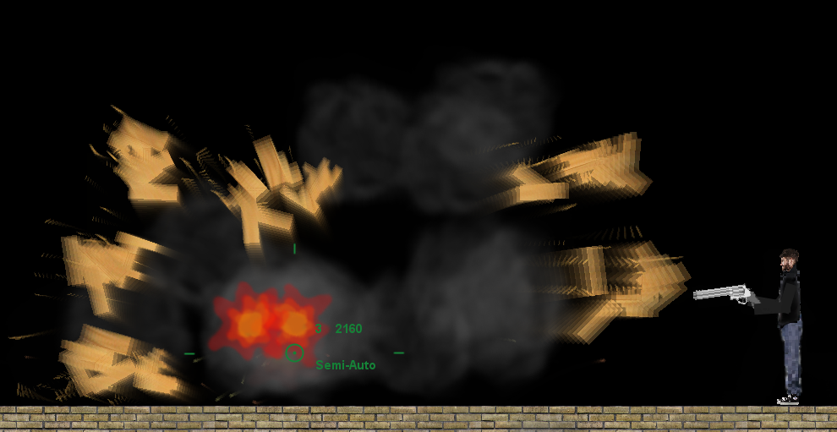
Motion Blur
Frame blending algorithm
Minimal performance loss
Notes:
performance loss is not based upon the number of blurred objects nor the velocity of moving objects

Slide 9
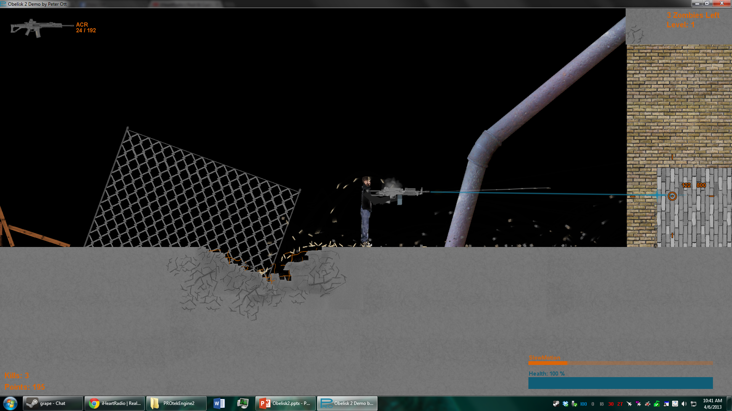
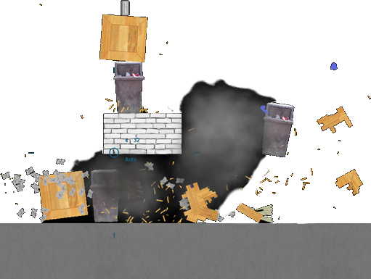
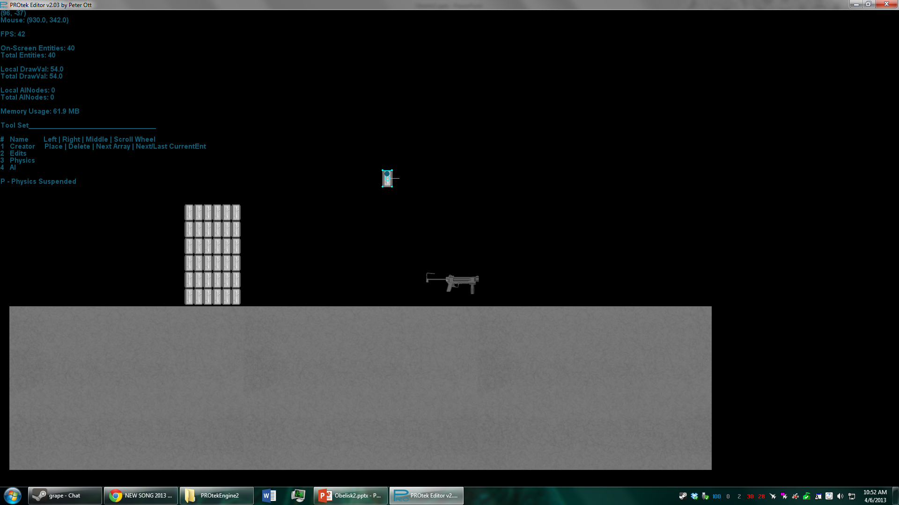
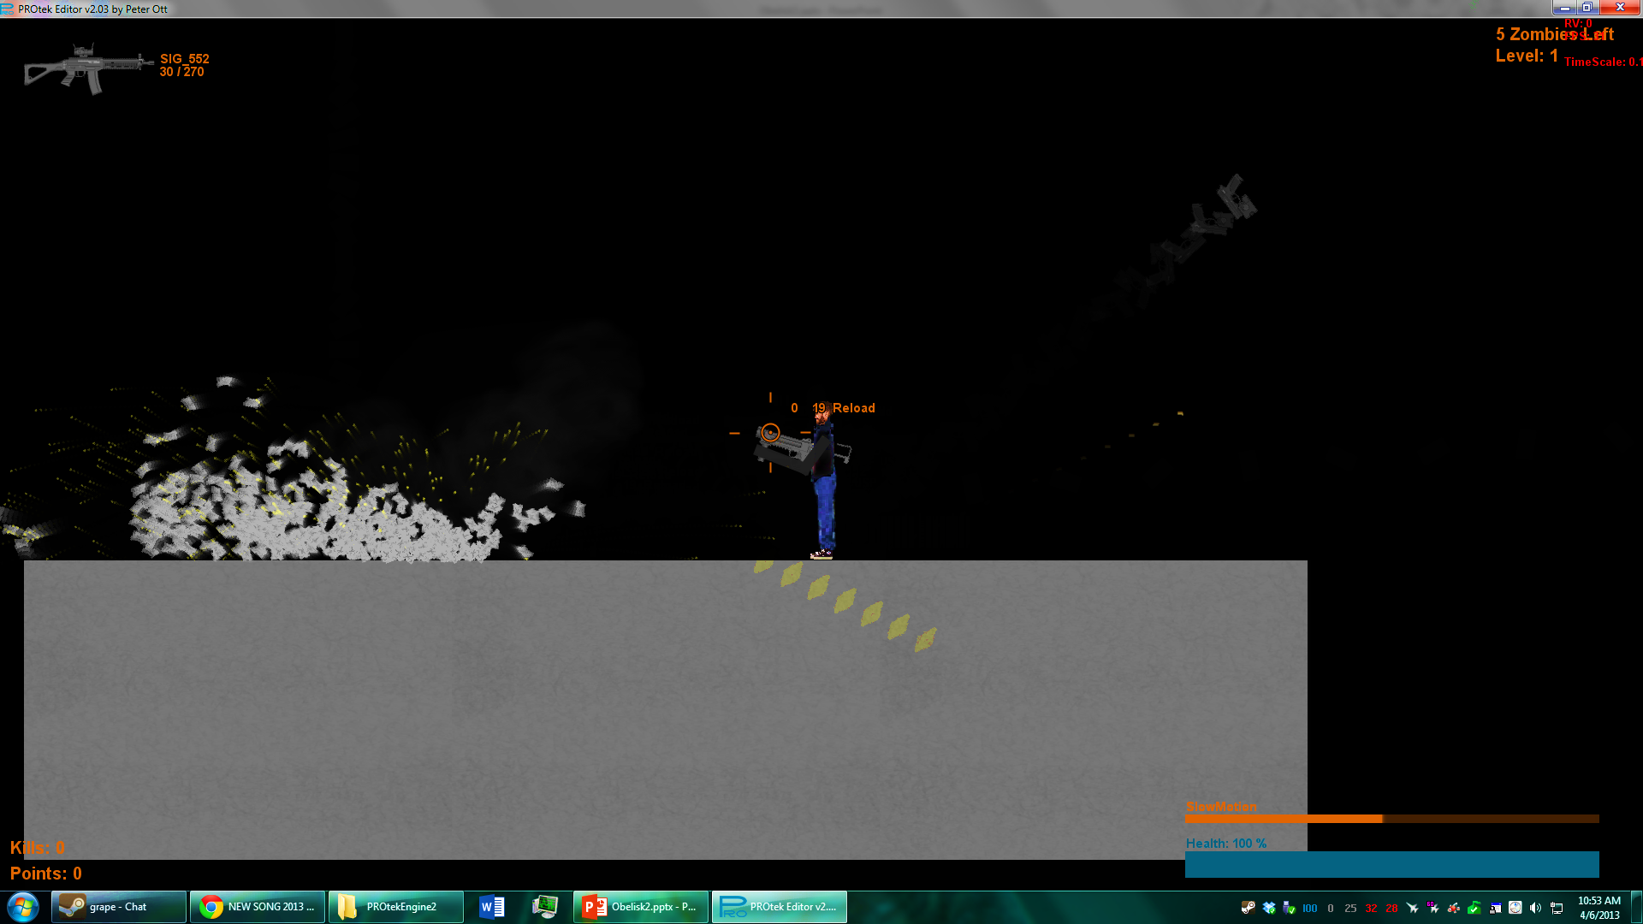
Particle System
Easily handle approximately 1,500 particles
Notes:
The PROTEK particle system uses a low amount of system resources to processes a massive amount of particles.

Slide 10
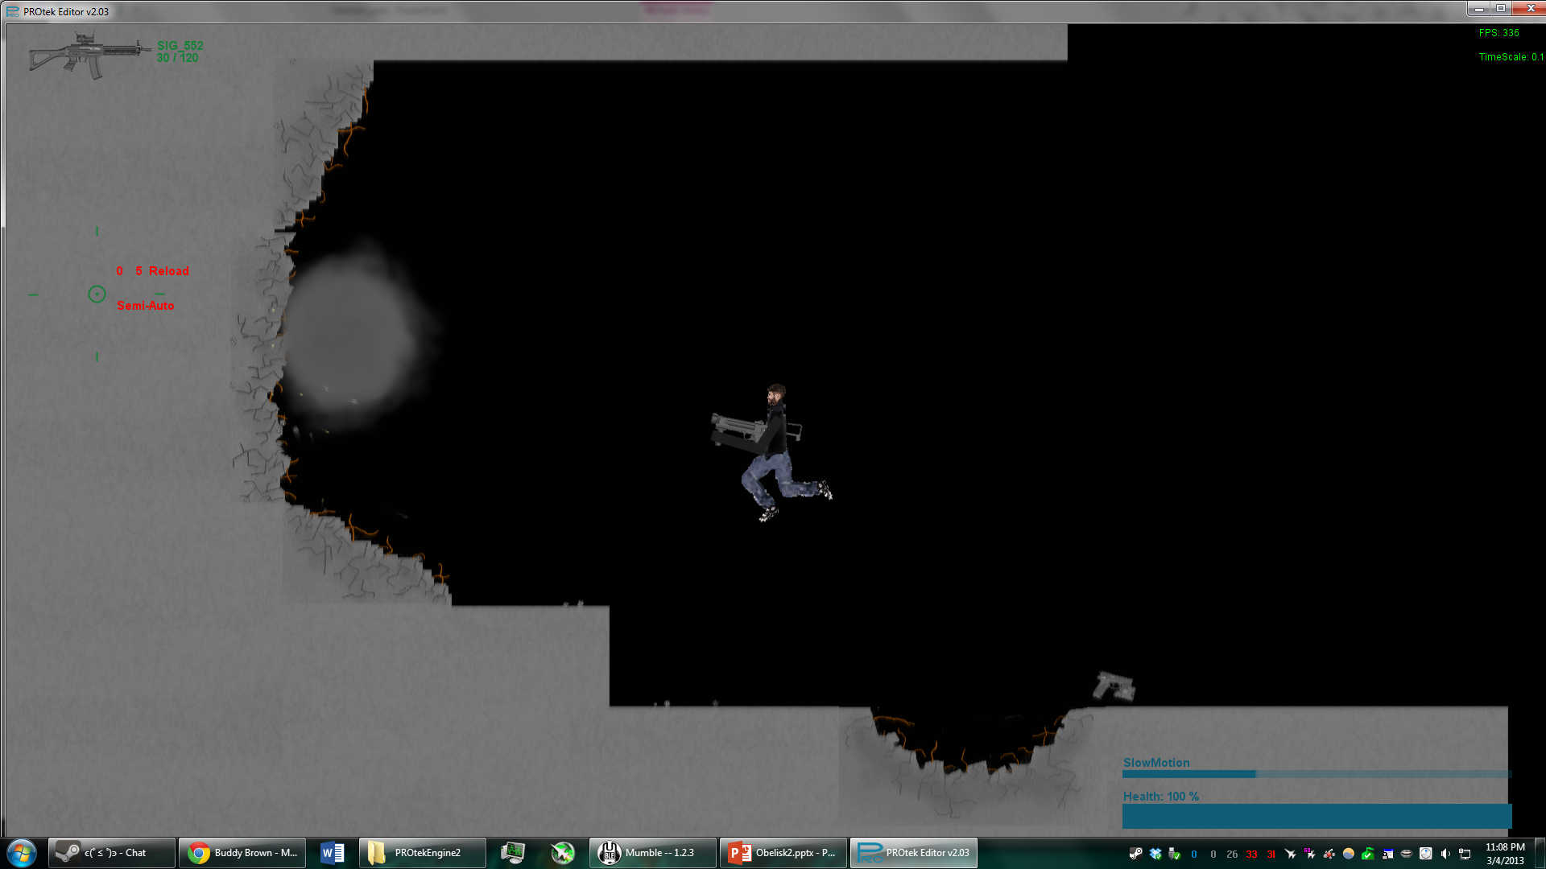
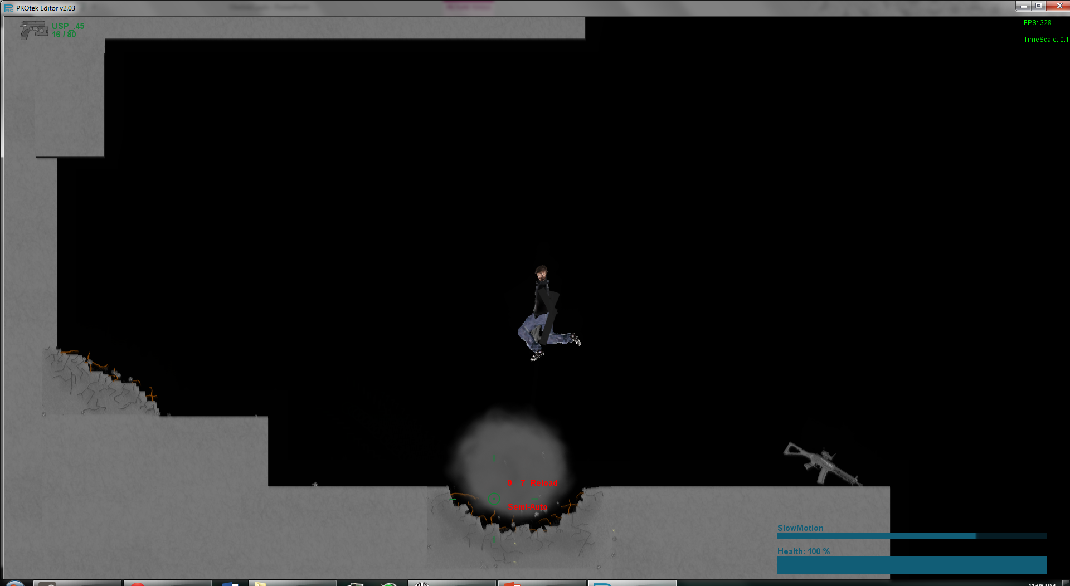
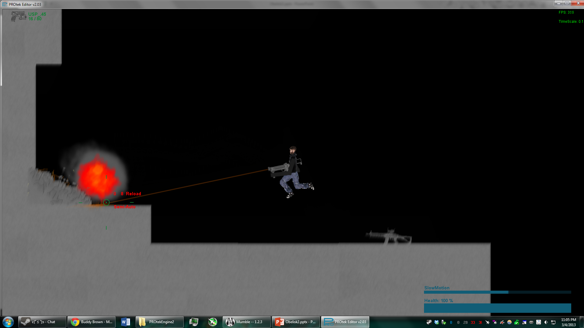
Destructible Environments
Explosives and high powered weaponry degrade environmental pieces
Notes:
Am amount of realism is added with the ability to destroy parts the environment

Slide 11
Multi-Threaded Constant Physics
Drag-Pass Algorithm for constancy
High Thread usage for high performance
Current space check
Drag-Pass
= hit
= miss
object
start
It. 1
It. 2
It. 3
object
object
start
It. 1
It. 2
It. 3
object
Notes:
While the physics simulates itself in increments the collisions are not skipped because of a drag-pass algorithm
The drag pass does not check every single point between the two iterated positions, instead it wipes over all of the spaces it would have covered and back tracks if there were any collisions.
The diagram is shows in 3 iterations how a drag pass algorithm is able to pick up collisions not normally picked up incremental iterations
The use of many threads makes this possible

Slide 12
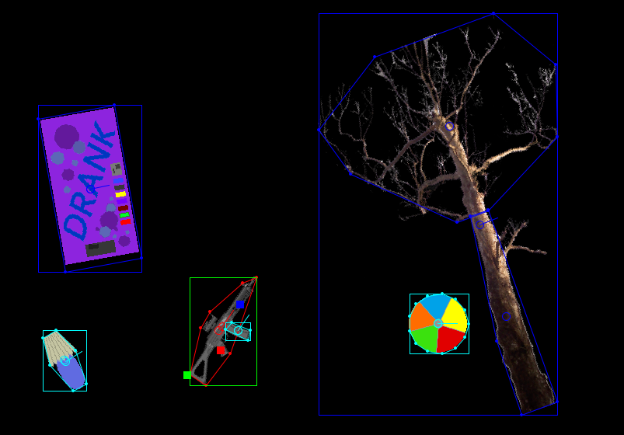
Wireframe Models
Convex Wireframes are used
Performance and Accuracy

Slide 13
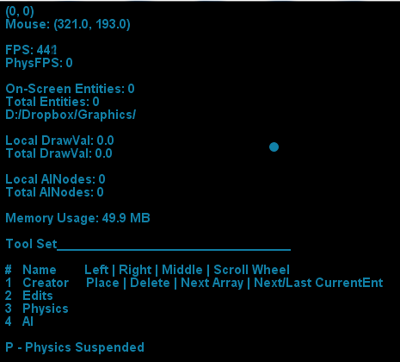
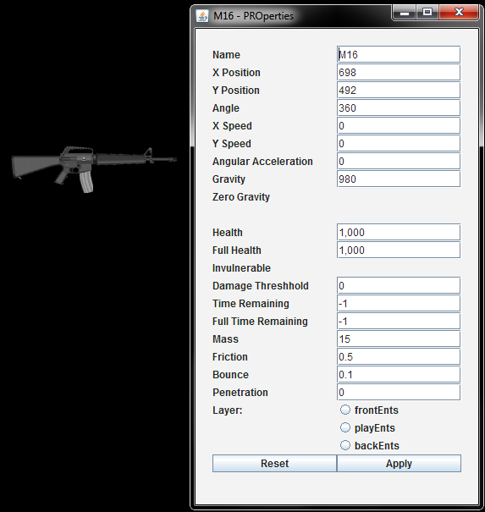
PROtek Editor 2.0
User created content made easy
Save, load, and share game levels
Notes:
This is available with the developer version of the game as the .jar version does not have saving capabilities

Slide 14
Metrics
17,189 Lines of Code
43 Class Files
307 Images
48 Sounds
9.79 Mb
1 Game

Slide 15
Download and Play
http://bit.ly/Obelisk2

